Slide 1

MILKCONNECT: E-commerce for Dairy Products
MILKCONNECT links dairy farmers directly to consumers. Enjoy fresh farm products delivered quickly.

Slide 2

Introduction to MILKCONNECT
Platform Purpose
Backend Technology
Connect dairy farmers to consumers via an online marketplace.
Java powers robust backend processing and service operations.
Data Structure Optimization
Use of efficient algorithms ensures fast, reliable functioning.

Slide 3




Java Technologies Used
JAVA 24 JDK
JDBC
Accelerates code writting by providing new and many libraries.
Supports connection between JAVA and SQL database to store the data.
MYSQL Database
Simplifies database access and management.

Slide 4



Data Structures for Inventory Management
Sorting Algo.
2
Filtering the products based on any parameter with efficient time.
Stacks
For keeping the track of the logged in users.
1
3
Priority Queue
For Scheduling the order delivery system.

Slide 5
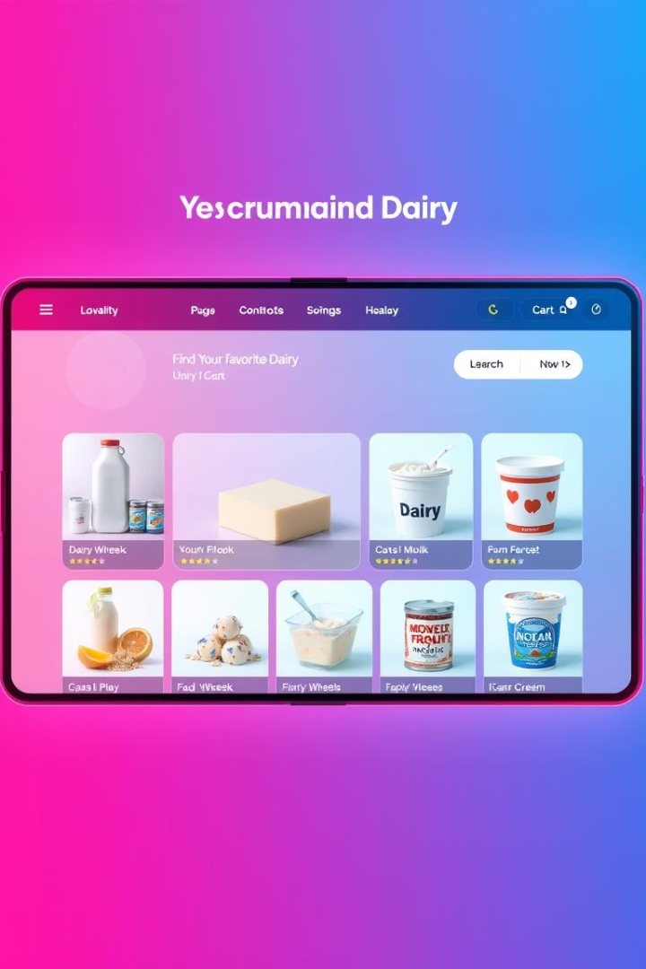
Algorithms for Recommendation Systems
Collaborative Filtering
Suggests products based on user behavior similarity.
Content-based Filtering
Recommends items with similar attributes to user preferences.
Association Rule Mining
Detects commonly bought product bundles using Graphs.
(To be implemented).

Slide 6




DSA for Efficient Delivery Routing with SQL Database
Merge Sort Algorithm
Filters products based on parameters efficiently, retrieving data dynamically from the SQL database.
Search Algorithm
Optimizes routing by querying SQL data and considering constraints like traffic and delivery status.
Dynamic Programming
Reduces overall delivery costs through cost minimization, leveraging stored data and computations from the SQL database.

Slide 7

Data Security and Java Security Features
Data Encryption
Security
Protects sensitive info like Passwords and personal data.
Handles authentication and authorization robustly.
Secure Coding Practices
Prevents vulnerabilities following some guidelines.

Slide 8
Project Design and Timeline
Design Phase
Testing Phase
Define requirements, architecture, and design specifications.
Perform thorough testing to ensure quality and fix issues.
1
2
3
4
Development Phase
Deployment
Implement features and write code according to design.
Release the product to production and monitor performance.

Slide 9
Performance Optimization and Scaling
Code Optimization
Database Strategies
Scaling Techniques
Refactor and streamline code for faster execution.
Indexing and query tuning speed up data access.
Load balancing and caching handle high traffic.

Slide 10

Future Enhancements and Conclusion
Machine Learning
1
Demand forecasting to optimize stock and sales.
2
IoT Integration
Real-time inventory tracking for freshness and supply.
Q&A
3
Engage with questions and discuss next development steps.

